Slide 1


2025
Brand Guidelines

Slide 2
Logos

Slide 3
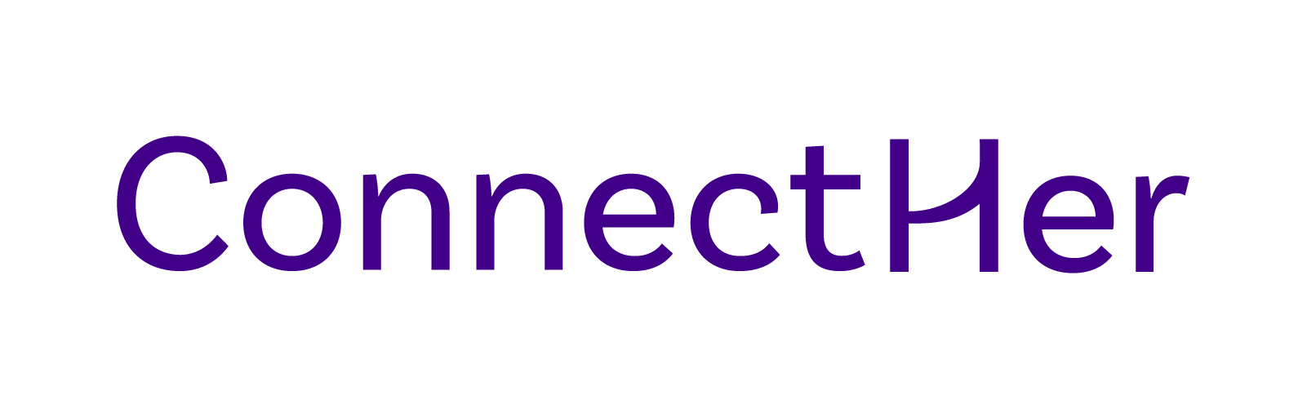

Logos
1.
2.
horizontal logo
to be used first, it’s the logo for the public to remember.
wordmark
to be used for favicon.
Minimum height : 5mm
Download Here

Slide 4
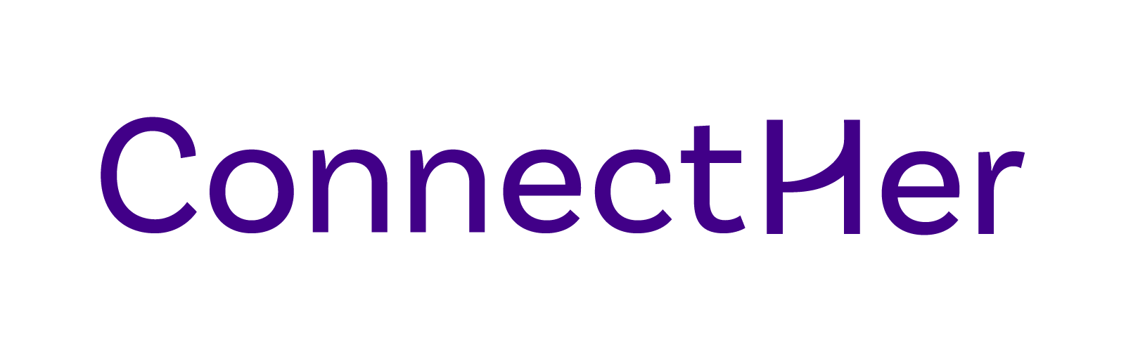
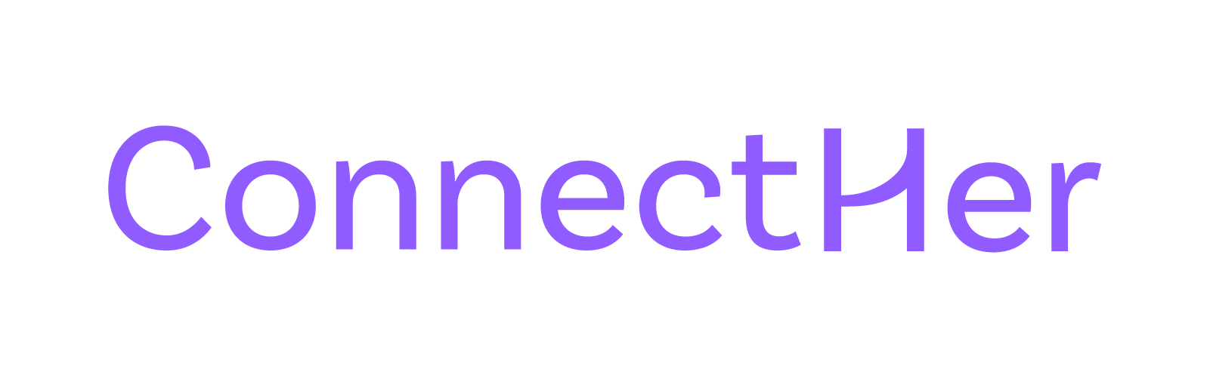

Logo
Color Variations
Many variations of the logo are possible. Be careful to keep the maximum visibility of the entire logotype.

Slide 5
Colors

Slide 6
Colors
Purple
Light Purple
Lila
Blue
Beige
Orange
#410088
#905CFF
#AF88FF
#92D2D8
#F7F5ED
#FF8600

Slide 7
Typography

Slide 8
Typography
Manrope
Whereas disregard and contempt
for human rights have resulted
This typeface is used for paragraphs and subheadings.
Download Here
Can be used in Regular, Semibold, Bold

Slide 9
Typography
Merriweather
Whereas disregard and contempt
for human rights have resulted
This typeface is mainly used for headlines or text to be highlighted.
Download Here

Slide 10
Iconography

Slide 11


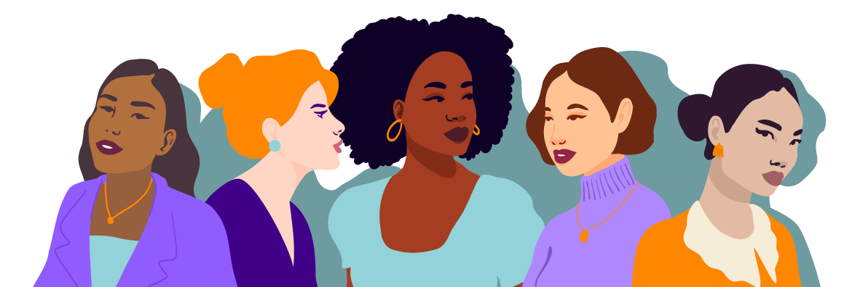

Iconography

Slide 12
Iconography
Icons
Download Here

Slide 13
Iconography
Team Headshots
Download Here

Slide 14
Application Examples

Slide 15
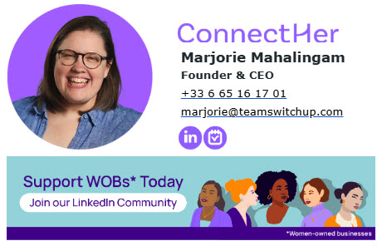
Applications
Email Signatures
New Message to
New Message to
Subject
Subject
Send
Send
Download Here

Slide 16

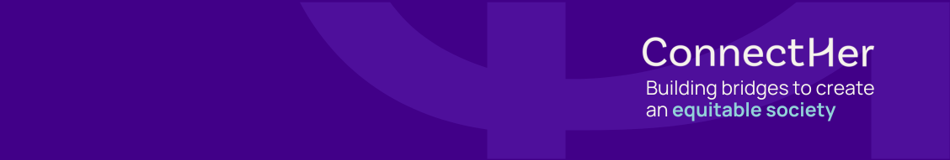
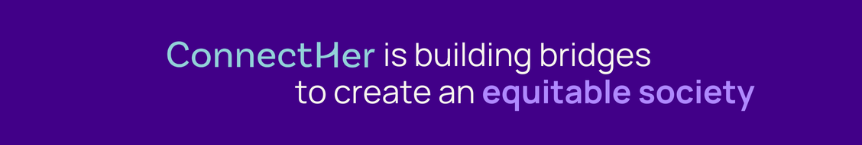
Applications
LinkedIn Banners x Business Account
Download Here

Slide 17
Applications
LinkedIn Banners x Personal Accounts
Download Here

Slide 18
Graphic Element Index
1
Logos
7
Email Signatures
2
Monogram
8
Presentation Template
3
Favicon
9
Business Cards
4
Illustrations
10
LinkedIn Business Banners
5
Pictograms
11
LinkedIn Personal Banners
6
Team Headshots
12
LinkedIn Campaign Templates

